Slide 1


Convolutional Neural Network

Slide 2
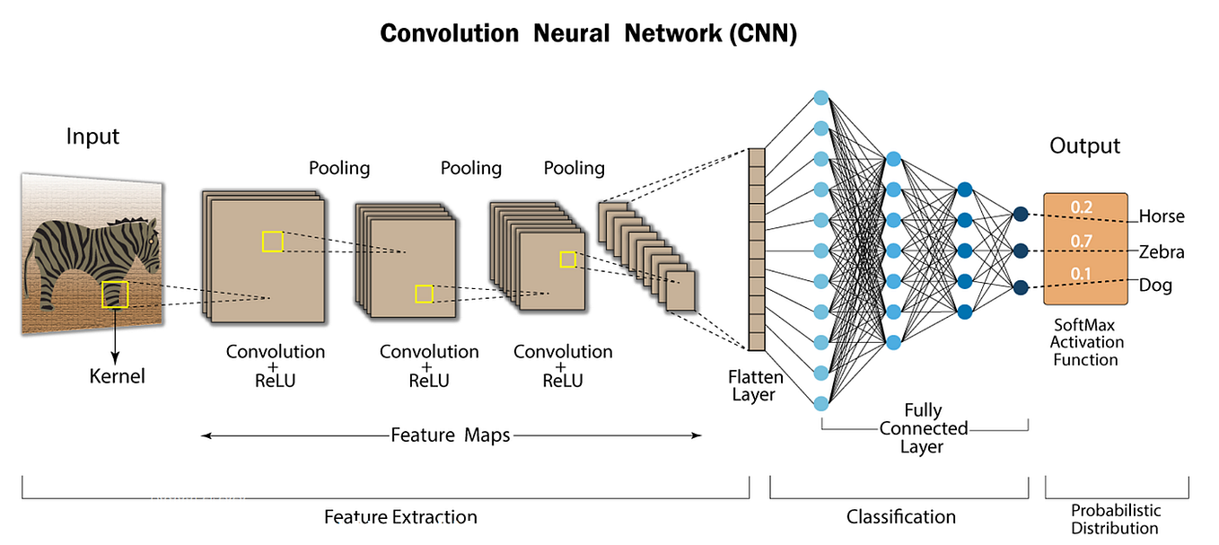
Introduction to Convolutional Neural Network
A Convolutional Neural Network (CNN) is a type of deep learning algorithm that can take in an input image, assign importance (learnable weights and biases) to various aspects/objects in the image, and be able to differentiate one from the other.

Slide 3
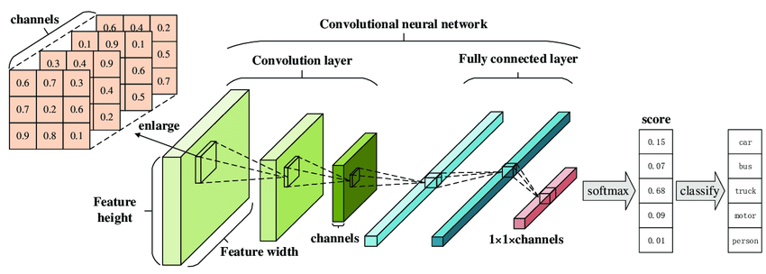
Convolutional Layers and Feature Maps
Convolutional Layers
Feature Maps
These layers apply a set of filters to the input data, allowing the network to learn specific features of the input.
Each filter generates a feature map. Feature maps represent the presence of a specific feature or pattern within the input data.

Slide 4
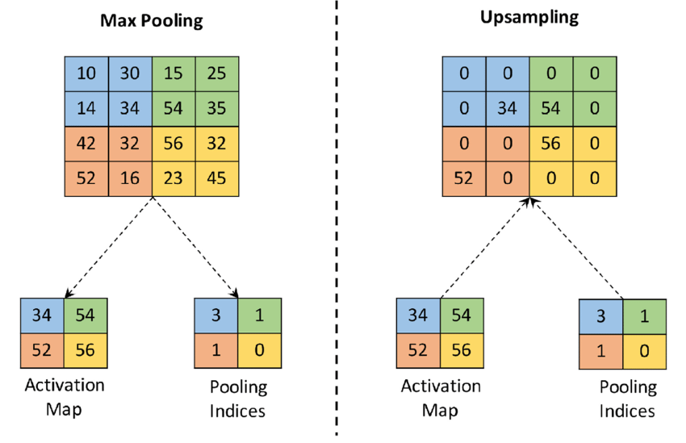
Pooling Layers and Down sampling
Pooling Layers
Downsampling
Downsampling refers to the process of reducing the size of the input data, thereby decreasing the computational load.
Pooling layers reduce the dimensions of the feature maps while retaining the most important information.

Slide 5
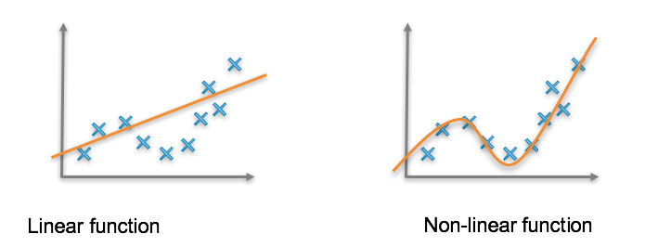
Activation Functions and Non-Linearity
1
Activation Functions
2
Non-Linearity
Activation functions introduce non-linear properties to the network, allowing it to learn and perform more complex tasks.
Non-linear activation functions allow CNNs to learn complex patterns and relationships in data that are not expressible using simple linear transformations.

Slide 6
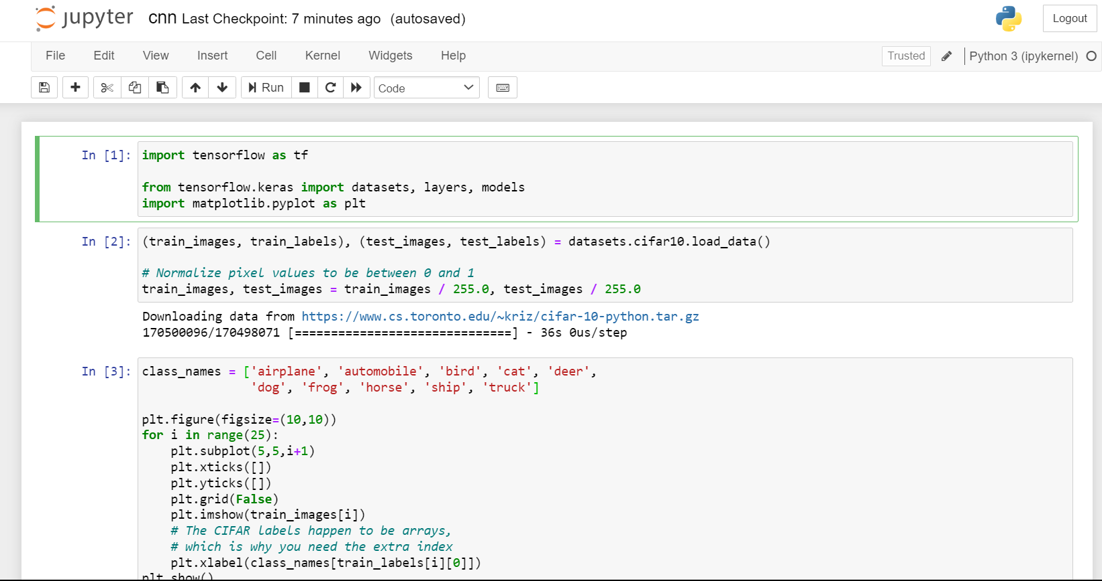

Slide 7
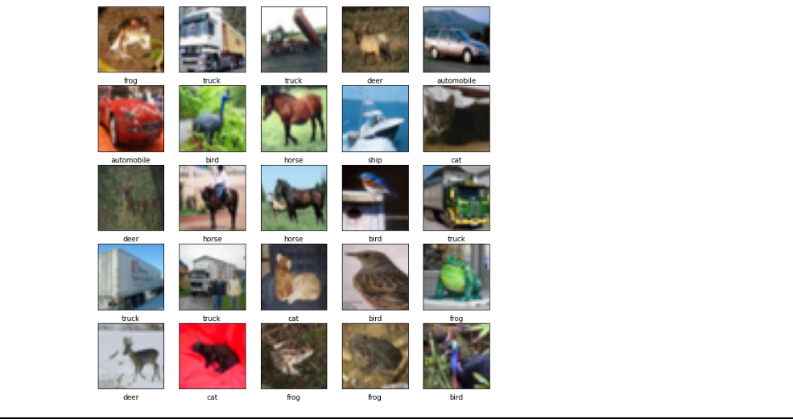

Slide 8
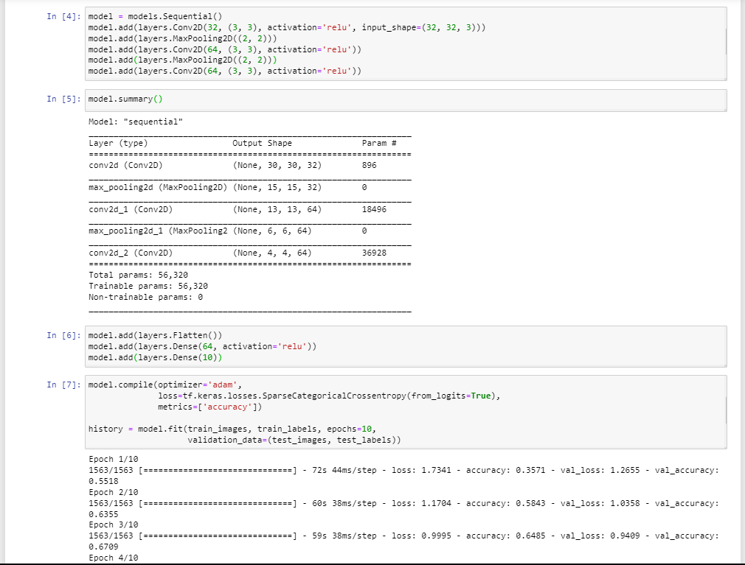

Slide 9
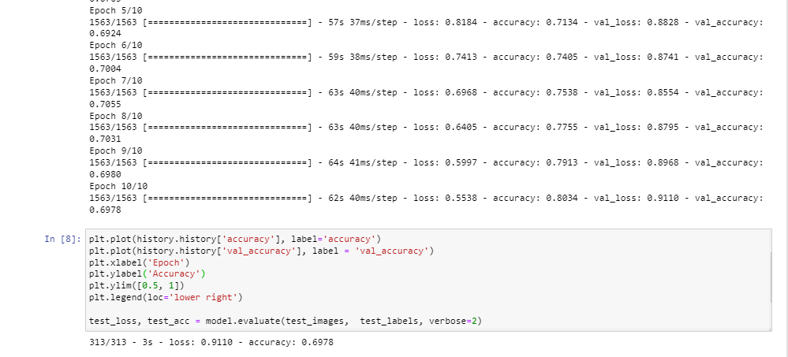

Slide 10
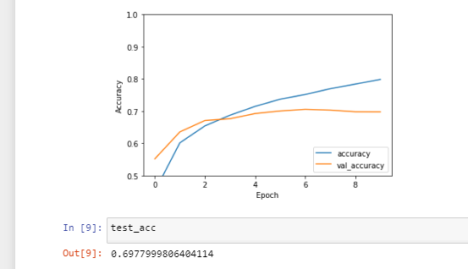

Slide 11
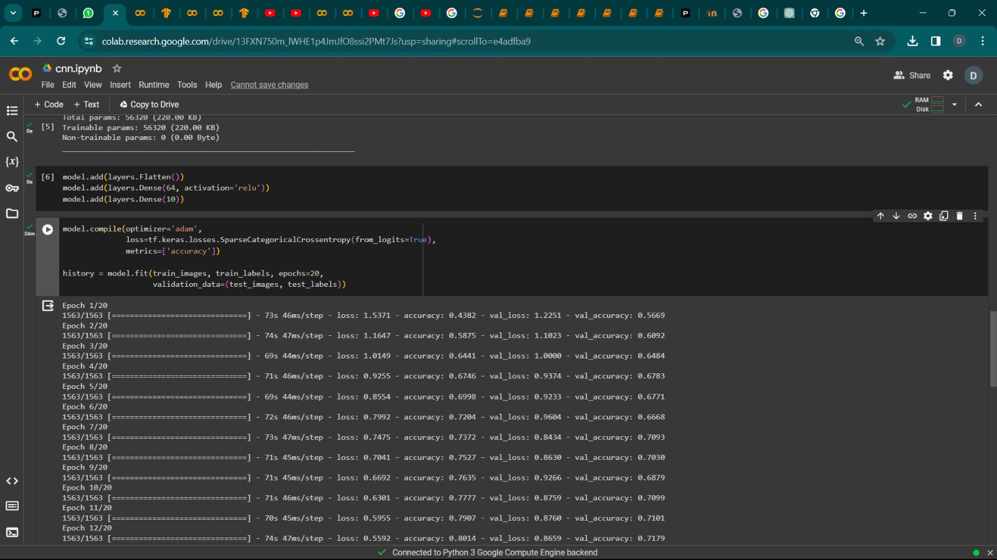
What If We Increase Number Of EPOCHS…

Slide 12
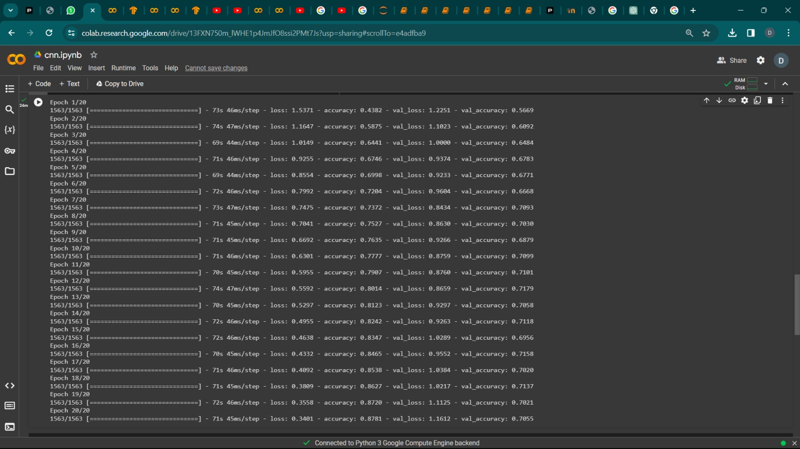
ACCURACY INCREASES….

Slide 13
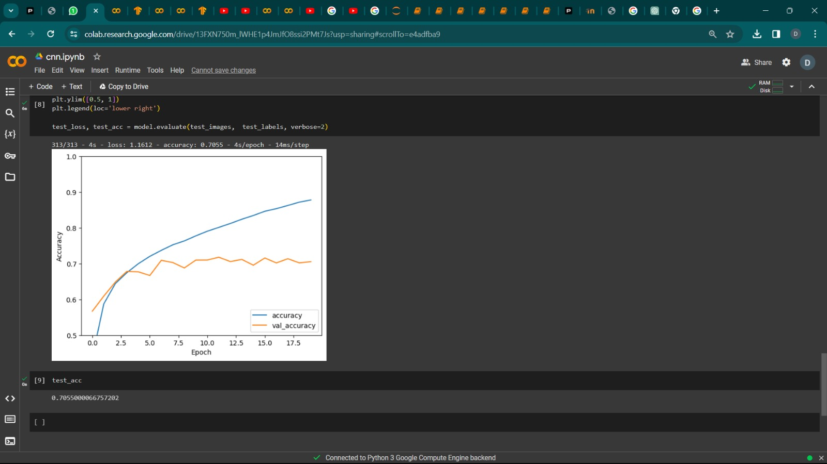
ACCURACY INCREASES….

Slide 14
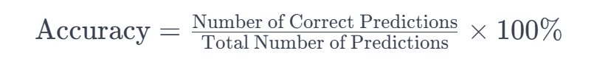
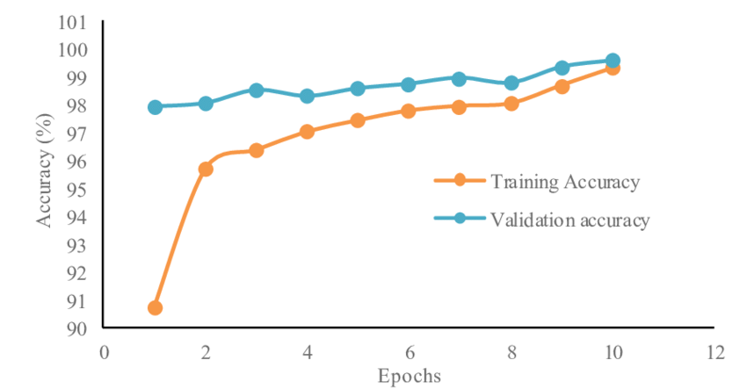
Accuracy In Convolutional Neural Networks (CNNs)
Convolutional Neural Networks (CNNs), "accuracy" typically refers to the performance metric used to evaluate the model's overall correctness in making predictions on a dataset. Accuracy is calculated as the ratio of correctly predicted instances to the total number of instances.
The accuracy output of a CNN is a measure of how well the model is performing on a given dataset. It is often expressed as a percentage and can be calculated using the following formula:

Slide 15
Fully Connected Layers and Classification
Fully Connected Layers
Classification
Fully connected layers connect every neuron in one layer to every neuron in another layer, providing a global understanding of the input data.
CNNs use fully connected layers to perform classification by assigning probabilities to different classes of input data.

Slide 16
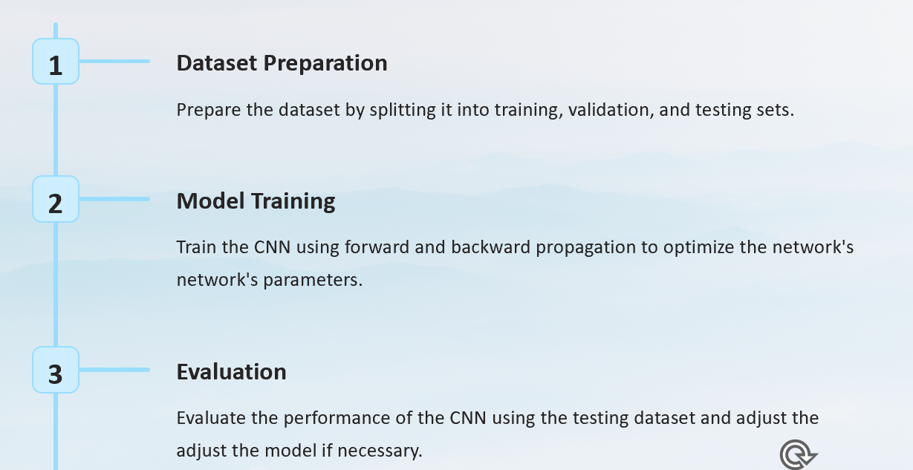
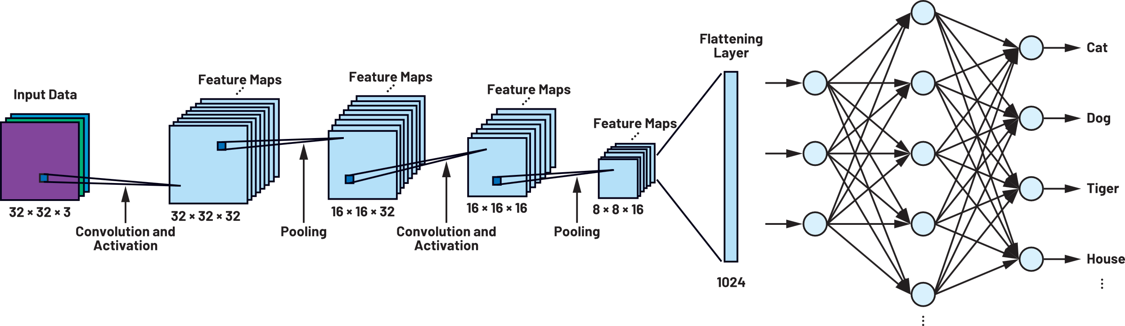
Training a Convolutional Neural Network

Slide 17




Common Architectures: LeNet, AlexNet, VGG, ResNet
LeNet
AlexNet
One of the earliest CNN architectures designed for handwritten and machine-printed character recognition.
Introduced deep convolutional neural networks to a broader audience by winning the prestigious ImageNet Large Scale Visual Recognition Challenge.
VGG
ResNet
A highly influential CNN architecture known for its simplicity and uniform architecture.
Revolutionized the field by introducing skip connections to tackle the vanishing gradient problem in very deep networks.

Slide 18
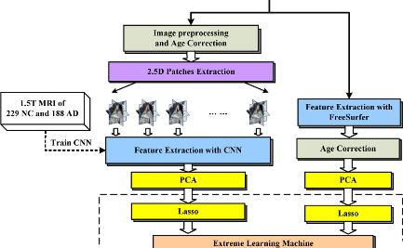
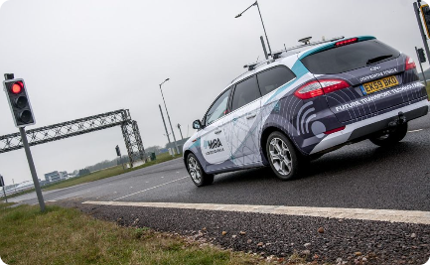
Applications of Convolutional Neural Networks
Medical Imaging
Autonomous Vehicles
Facial Recognition
CNNs are used for disease detection and anomaly identification in medical images such as MRIs and CT scans.
CNNs play a crucial role in object detection and scene understanding for autonomous driving systems.
CNNs are utilized for facial recognition in security systems, social media platforms, and mobile devices.

